Slide 1
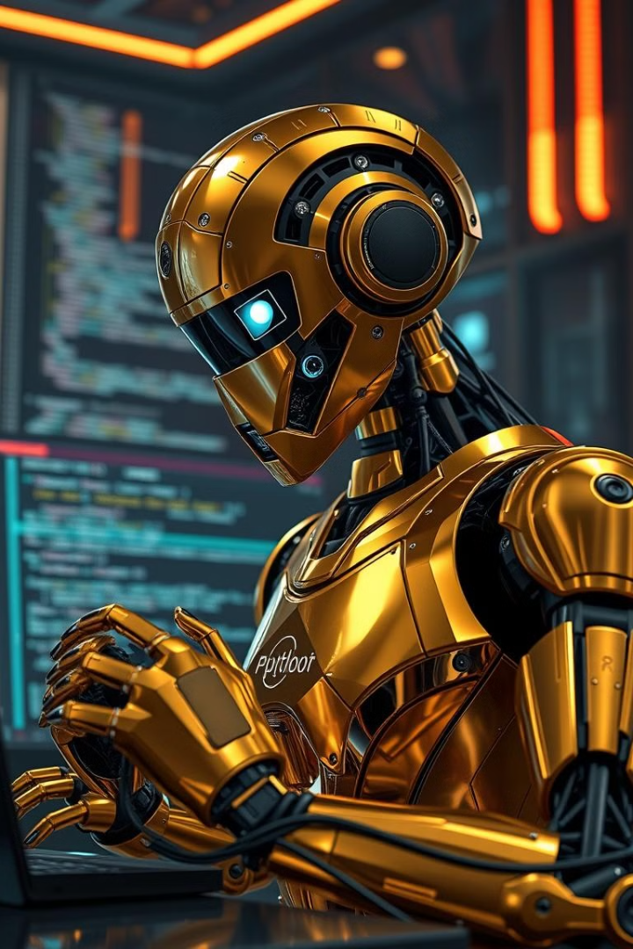
Project Report: Python Bug Detection and Fix Generation System
This project develops an AI-powered system that automates bug detection and fix generation in Python code snippets. The system consists of a Bug Detection Model and a Fix Generation API. The Bug Detection Model is a deep learning classifier based on BERT that determines whether a given Python code snippet contains errors.
The Fix Generation API utilizes Mistral-7B, a large language model, to generate corrected versions of the identified buggy code. By integrating these components, the system provides an efficient solution for debugging Python code while offering educational insights into common programming mistakes.

Slide 2
Problem Statement
Automated Bug Detection
Automated Fix Generation
Educational Assistance
Classifying Python code snippets as either buggy or bug-free.
Providing corrected versions of the identified buggy code.
Helping learners recognize and understand common Python errors, improving their programming skills.
Python developers frequently encounter syntax errors, logical bugs, and runtime exceptions. Manually identifying and fixing these issues can be tedious and requires a significant amount of expertise, making it particularly difficult for beginners. By implementing this system, developers can receive instant feedback on their code, reducing debugging time and improving overall code quality.

Slide 3

Scope
This project encompasses the following key functionalities:
Detects bugs in Python code snippets using a BERT-based classifier.
Generates fixes for buggy code using Mistral-7B via API.
Helps beginners learn by showing corrected code versions.
Serves as an educational tool for coding practice and debugging skills.
Supports short to medium-length code snippets.

Slide 4
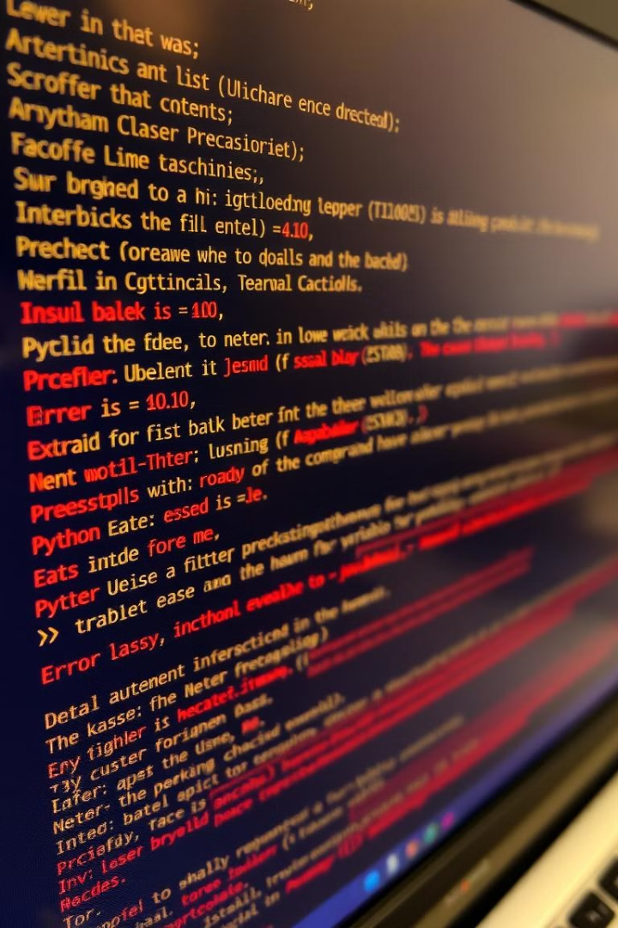
Dataset Overview
Code Snippets
Binary Labels
Synthetically generated Python code snippets dealing with logical and syntax errors.
Each code snippet is labeled as either buggy (1) or bug-free (0).
Corrected Versions
If applicable, the dataset includes the corrected version of the buggy code.
The dataset used for training and evaluation consists of synthetically generated Python code snippets. It contains over 100 examples balanced between buggy and bug-free instances. Each example in the dataset consists of the attributes code, label, and fix.

Slide 5



Bug Detection Model
Base Model
BERT (Bidirectional Encoder Representations from Transformers). BERT is a transformer-based model that learns contextual relationships between words in a text. It is pretrained on a large corpus of text data.
Input
Tokenized Python code snippets.
Output
A pooled representation passed through a classifier.
The Bug Detection Model is built using a BERT-based architecture. It uses a Transformer-based encoder with pretrained weights from bert-base-uncased. The input is tokenized Python code snippets, and the output is a pooled representation of the entire sequence, which is passed through a classifier to determine whether the code is buggy or bug-free.

Slide 6




Fix Generation Model
Model
Type
1
2
Mistral-7B-Instruct.
Large Language Model (LLM).
Output
4
3
Input
A corrected version of the buggy code.
A buggy Python code snippet.
The Fix Generation Model is based on Mistral-7B-Instruct, a large language model designed for text generation tasks. Mistral-7B is a 7.3 billion parameter model known for its strong performance and efficiency. To guide the model in generating fixes, a structured prompt is used. This ensures that the model focuses on providing corrected code snippets without unnecessary explanations.

Slide 7
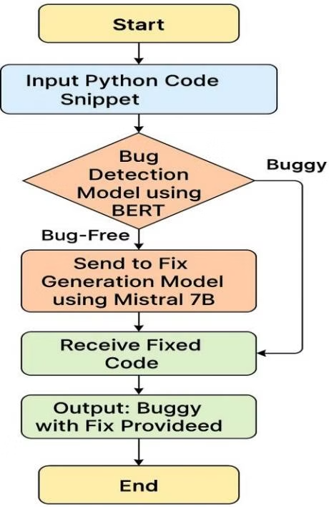
System Workflow
1
Input
Python code snippet.
2
Bug Detection
Code is tokenized and classified.
3
Fix Generation
Corrected code is returned.
The system workflow involves inputting a Python code snippet, detecting bugs using the BERT-based classifier, and generating a corrected version of the code using the Mistral-7B model. The system provides a classification result (Buggy / Bug-Free) and, if the code is buggy, a suggested fix is generated.

Slide 8

Evaluation Metrics
91.30%
95.45%
Accuracy
F1-Score
Overall accuracy in detecting buggy code.
Harmonic mean of precision and recall.
11.70%
BLEU Score
Average BLEU score for fix generation.
The Bug Detection Model achieved an overall accuracy of 91.30%, effectively detecting buggy code but failing to correctly classify bug-free instances, likely due to class imbalance. The fix generation model was tested using several sample bug fixes, with similarity and BLEU scores calculated.
The results indicate that while the model generates syntactically correct fixes, improvements are needed to align fixes more closely with ground truth solutions. Prompt engineering and fine-tuning could enhance performance further.

Slide 9
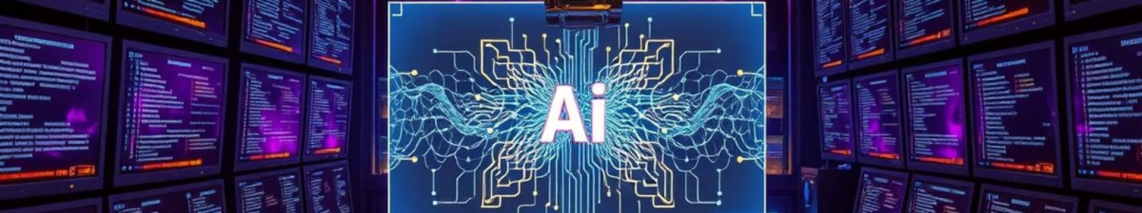
Conclusion and Future Work
Feasibility
Accuracy
Future Work
Demonstrated feasibility of AI-driven bug detection and fix generation.
Achieved 91% accuracy in bug classification.
Refining the fix generation model for improved accuracy and usability.
This project successfully demonstrates the feasibility of AI-driven bug detection and fix generation, achieving a 91% accuracy in bug classification and reasonable performance in code correction. Future work will focus on refining the fix generation model for improved accuracy and usability.

